Slide 1
Facebook Data Analysis
Avani Sharma
3 September, 2018
Data sOURCE:
https://www.kaggle.com/sheenabatra/facebook-data

Slide 2
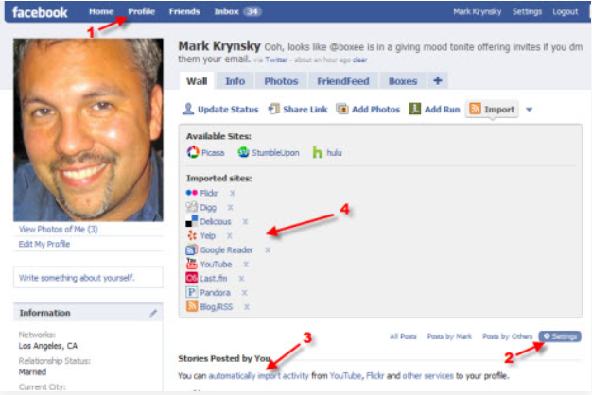
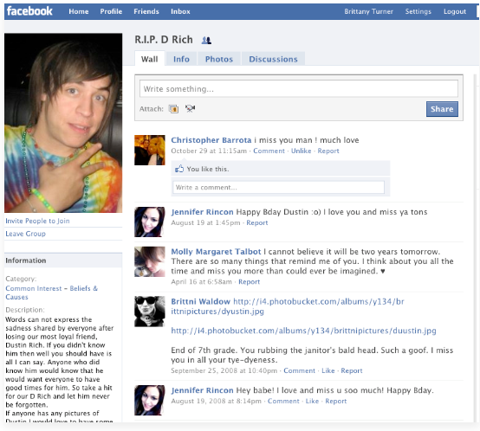
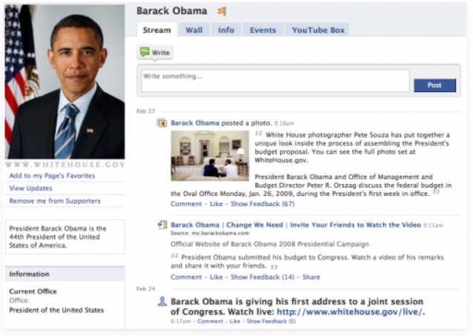
Variables
Age
dob_year
dob_month
gender
tenure
dob_day
friend_count
friendships_initiated
likes / likes received
mobile likes / likes received
www likes / likes received

Slide 3
Exploratory Data Analysis : Key Insights
Gender Interaction
Women interact more with fb then men
Women receive & give more likes than men on average
Likes Split Up
Shows inclination towards mobile apps
More prominence of likes from mobile compared to site though few users still interact with sites
User Counts
Bump between 1940 to 1980
No. of users in dataset depict a bump from 1940 to 1980 (50-60 year olds)
Women initiate less friendships than men compared proportionally to friend count
There can be a gradual shift from mobile to site in years to come seeing the trend
Age Distribution shows peak between 15-28 years, then small peak between 45-55 years. It seems like ages of parents and kids of a generation.

Slide 4

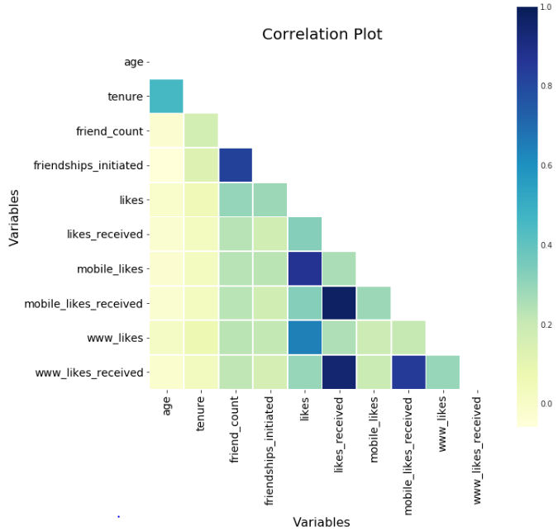
Correlation Plot
Friend count & friendships initiated are strongly correlated
Ignore correlations of subsets of likes & likes received (mobile & site likes/likes received)
Tenure and Age also seem to be related

Slide 5
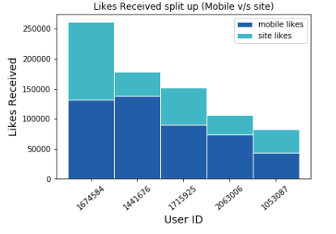
Likes / Likes Received
Likes Received
It's a many to one relationship, many people give likes to a user.
Top users likes show shift of people preferences towards mobile apps rather than site (mostly higher mobile likes than site likes)

Slide 6
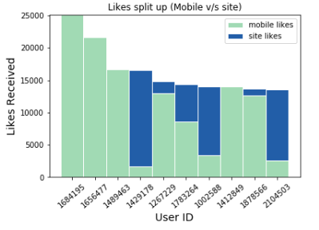
Likes / Likes Received
Likes given
It's a one to many relationship, a user gives likes to many people.
Top 4,6,7 & 10 user prefer the site more than mobile app
Still a general skew towards mobile app

Slide 7
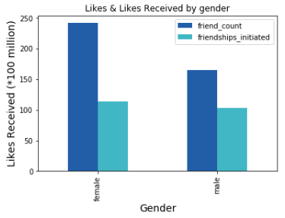
Gender Specific Interaction
Women like as well as are liked a lot more than men (nearly 2.5 as much).
Likes & likes received are comparable to each other for both men & women.
Same behavior is true when the likes/like received are split up between mobile & site (nearly 3 times more for women than men)

Slide 8
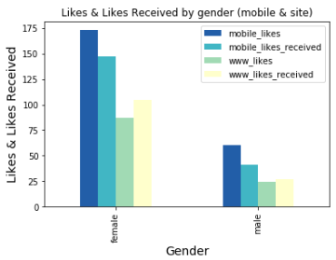
Average likes & likes received by men & women split up by medium
Women receive and give nearly 3 time more likes both on mobile & site
Likes received are more from site then likes given (raises question on mobile app popularity)

Slide 9
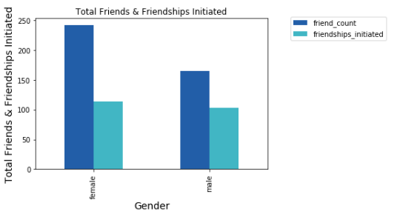
Women have more friends than men on facebook, the friendships initiated in proportion to friend count are more in case of men than women

Slide 10
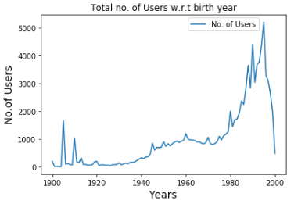
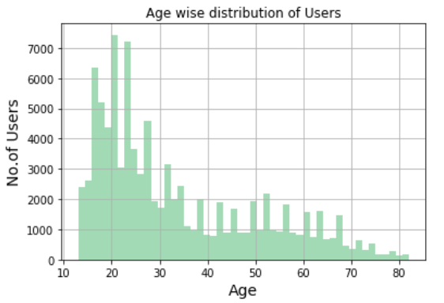
Users w.r.t birth year
We see bumps between 1940 to 1980. After 1980 the no. users rocket. Since the data is till 2000 (we see miniscule value in 2000)
Age Distribution shows peak between 15-28 years, then small peak between 45-55 years. It seems like ages of parents and kids of a generation.

Slide 11
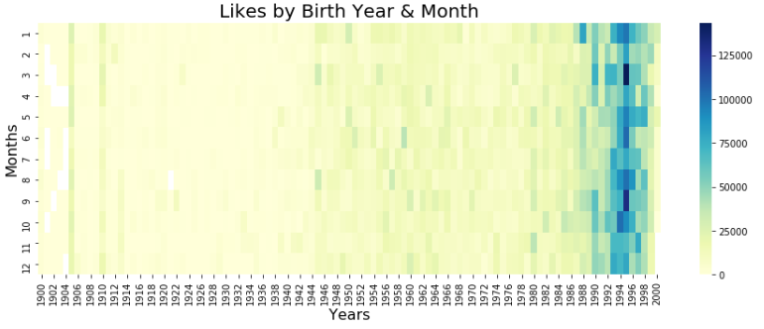
Likes by Birth Year & month 1. As years are increasing there are more number of likes 2. Month prominence for year 1994-95, two months standout September & March

Slide 12
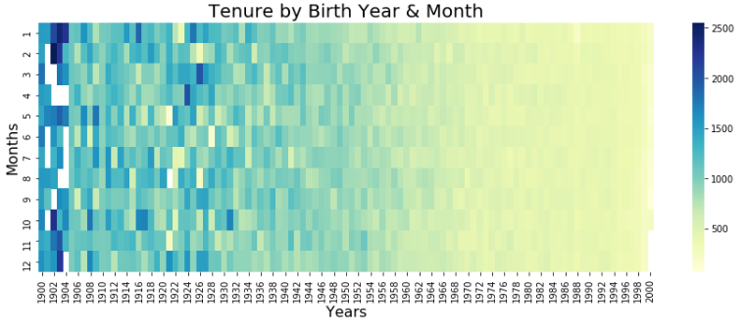
Tenure by Birth Year & month The early years seem to have more mean tenure, might be facebook pages or public user accounts that are mass followed

Slide 13
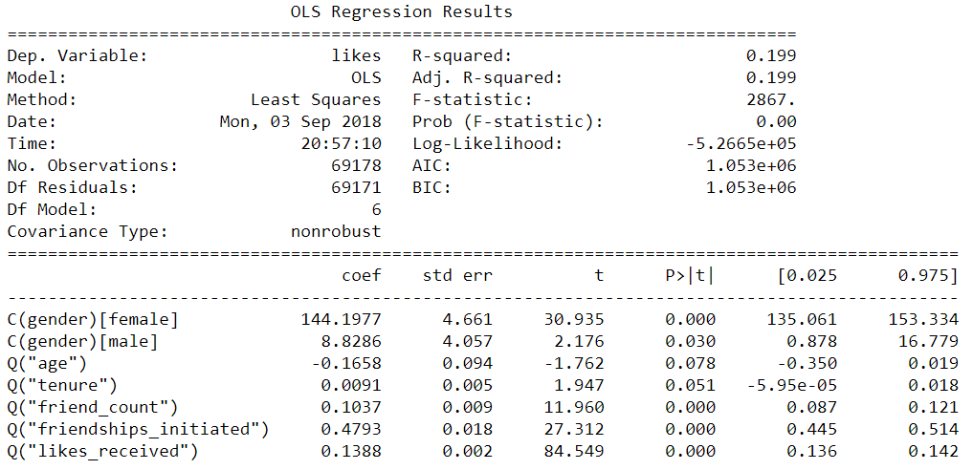
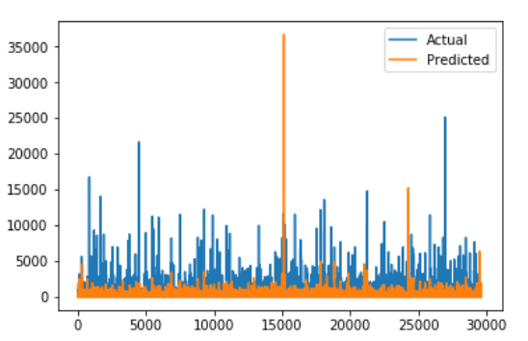
Modelling
Equation: likes ~ age + tenure + friend_count + friendships_initiated + likes_received + gender

